Slide 1


UTILIZATION OF SUGAR MILL AND MOLASSES BASED DISTILLERY BY-PRODUCTS FOR IMPROVING SUGARCANE YIED AND SOIL HEALTH.
RAO SHAFEEQUE MUHAMMAD
Mgr-MAS, Matiari Sugar Mill, Sindh.

Slide 2

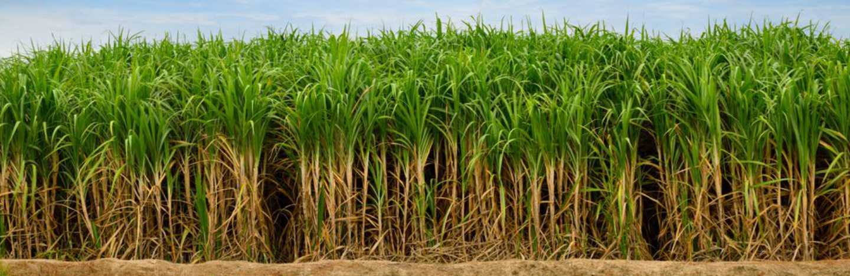
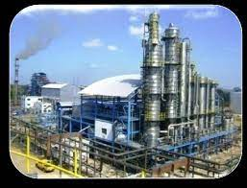
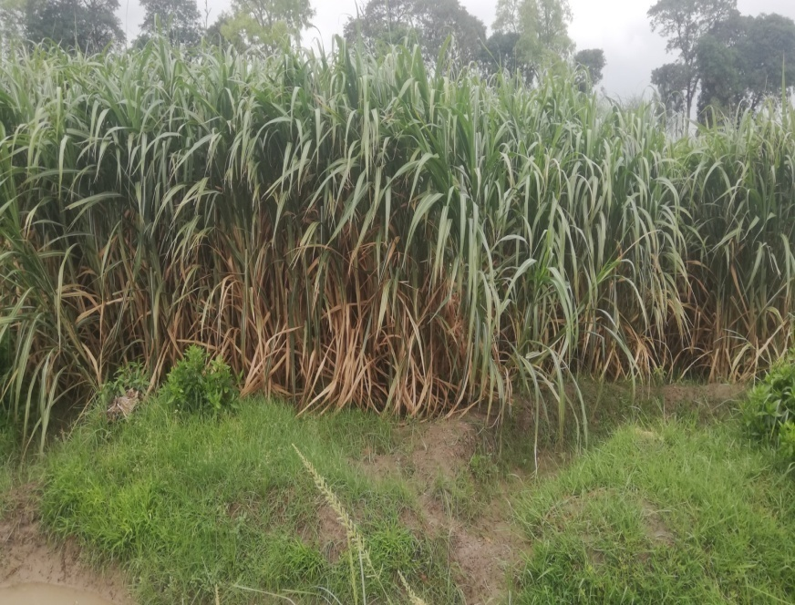
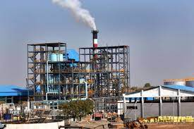
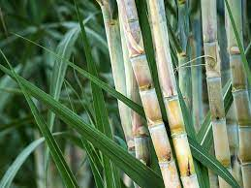
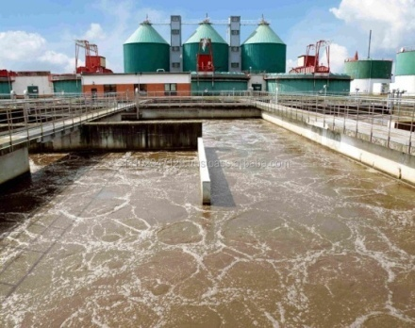
INTRODUCTION
Sugarcane is one of the largest cash crop. It plays a vital role in agricultural economy of Pakistan.
It generates income for all the stake holders, and is a key source of employment for the farming community.
Sugarcane is primarily grown for sugar production and tolerates harsh weather conditions i.e. rain & heat.
It has a lengthier duration than other cash crops, so farmers need great skill and plan to face a congregated problems, including the increasing cost of inputs and labor as well as scarcity of water.
Pakistan occupy an important position in cane producing countries of the world. It ranks at the fifth position in cane acreage production and almost 15th position in sugar production.

Slide 3

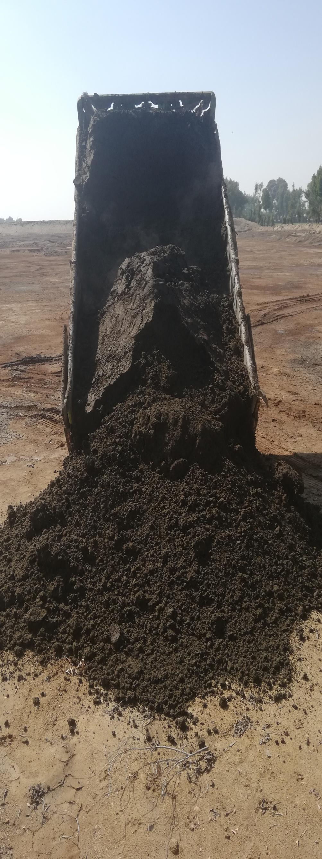
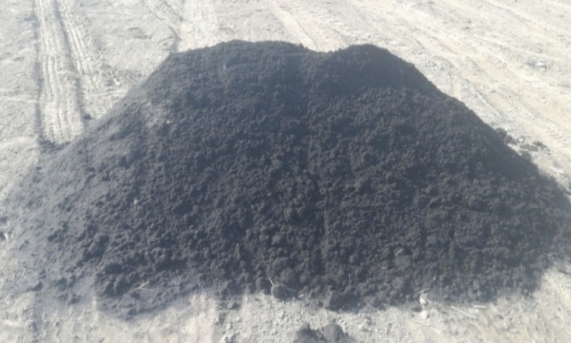
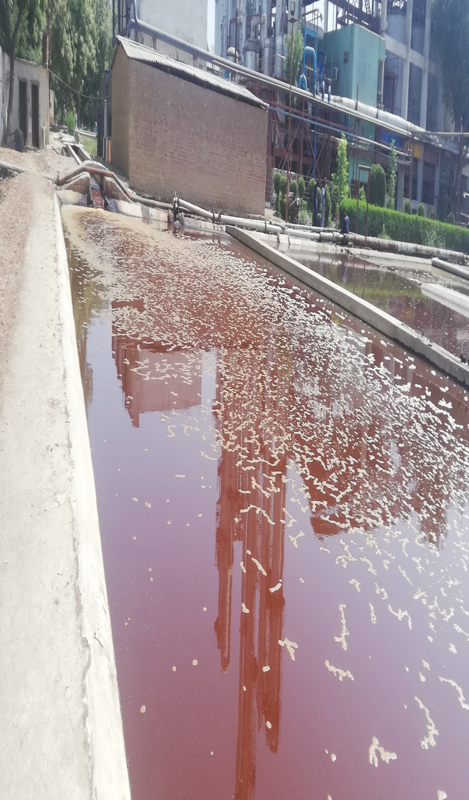

SUGAR INDUSTRY BY-PRODUCTS
Manufacturing processes would result in bio-products. Economic utilization of these by-products add to incomes. The sugarcane industry is no exception to this. It generates a various byproducts which are supportive for agriculture, Such as press-mud, boiler ash and spent wash. A sensible handling of these by-products can not only be helpful in addressing the climatic issues but also provide an opportunity to utilize them in agriculture as an organic source of nutrient for field crops yield and soil health. A number of researchers have already carried out studies and proved the usefulness of sugar industry bio-products in agriculture. A sustained efforts should continue in this regard.
PRESS MUD
BOILER ASH
DISTILLERY
SPEN WASH

Slide 4

DONOR OF ORGANIC MATTER IN SOIL
Our inherited soil continue to lose fertility because of intense cropping. It is essential to replenish the soil with organic matter by existing resources and this should be maintained on sustainable basis.
Sugarcane industry by-products are the reservoirs of organic matter which recover and sustain the soil health, as well as it improves the soil physical health (structure, texture, water-holding capacity, and porosity), chemical (pH, EC, CEC) and biological (microbial dynamics) properties.
These by-products are loaded with Beneficial Microorganisms which support in the mineralization of nutrients in the soil and make them able to uptake by plan roots.
After applying these materials microbes produce Enzymes, amino acids, auxins and other growth regulators, which help successfully in the plant propagation system as well resolve the nutrients deficiency of the soil and ultimately increases the biomass yield of crop.

Slide 5

SOURCES OF BIO-NUTRIENTS FOR CROPS
It has been estimated that 100 t of sugarcane produced from 1 ha land, which removes 140, 34 and 332 kg NPK ha⁻¹ respectively from soil. The high requirement of plant nutrient and scarcity of fertilizers in peak season resulting low yield of cultivated crop.
The prices of DAP, SOP and Urea fertilizers are getting beyond the purchasing power of farmers. Besides, nonstop use of chemical fertilizers can have an adverse impact on the agriculture productivity.
In this situation, sugarcane industries by-products are doable and cheaper sources of nutrients supplements for our field crops.
In this regards, sugarcane crop sown at Matiari Sugar Mill research farm and applied only press-mud, boiler ash and DSW before sowing which have given significant results by improving the crop and soil health. Interestingly, it is worth-mentioning here that no chemical fertilizers used in this crop.
It is suggested to adopt these economical sources of bio-nutrients in our cropping system wherever possible to reducing the chemical fertilizers. Its importance in day-to-day life adds its value.

Slide 6


NUTRIENTS AVAILABLE IN SUGAR INDUSTRY BIO-PRODUCTS
NUTRIENTS | PRESS-MUD |  | DSW |  | BOILER ASH
UNITS | mg k⁻¹ | % | mg L⁻¹ | % | mg k⁻¹ | %
Nitrogen | 20000 | 2 | 4200 | 0.42 | 400 | 0.04
Phosphorous | 13000 | 1.3 | 3038 | 0.3038 | 900 | 0.09
Potassium | 19500 | 1.95 | 17475 | 1.7475 | 5900 | 0.5
Sulphate | 17300 | 1.73 | 5100 | 0.51 | 8160 | 0.816
Calcium | 27000 | 2.7 | 7000 | 0.7 | 3600 | 0.36
Magnesium | 8500 | 0.85 | 2100 | 0.21 | 2400 | 0.24
Zinc | 125 | 0.0125 | 3425 | 0.3425 | 65 | 0.0065
Copper | 64 | 0.0064 | 0.4 – 2.1 | - | 55 | 0.0055
Iron | 3220 | 0.322 | 6.3 – 7.5 | - | 267 | 0.0267
Maganese | 298 | 0.0298 | 4.6 – 5.1 | - | 194 | 0.0194
Organic Carbon | 488000 | 48.80 | - | - | - | -
Organic matter | 210000 | 21 | - | - | - | -

Slide 7

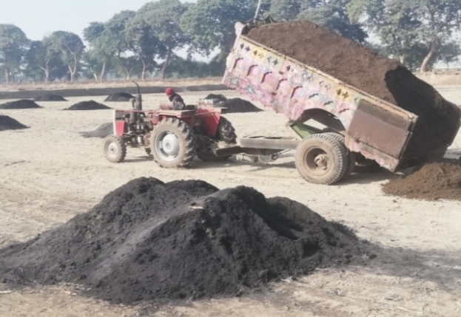
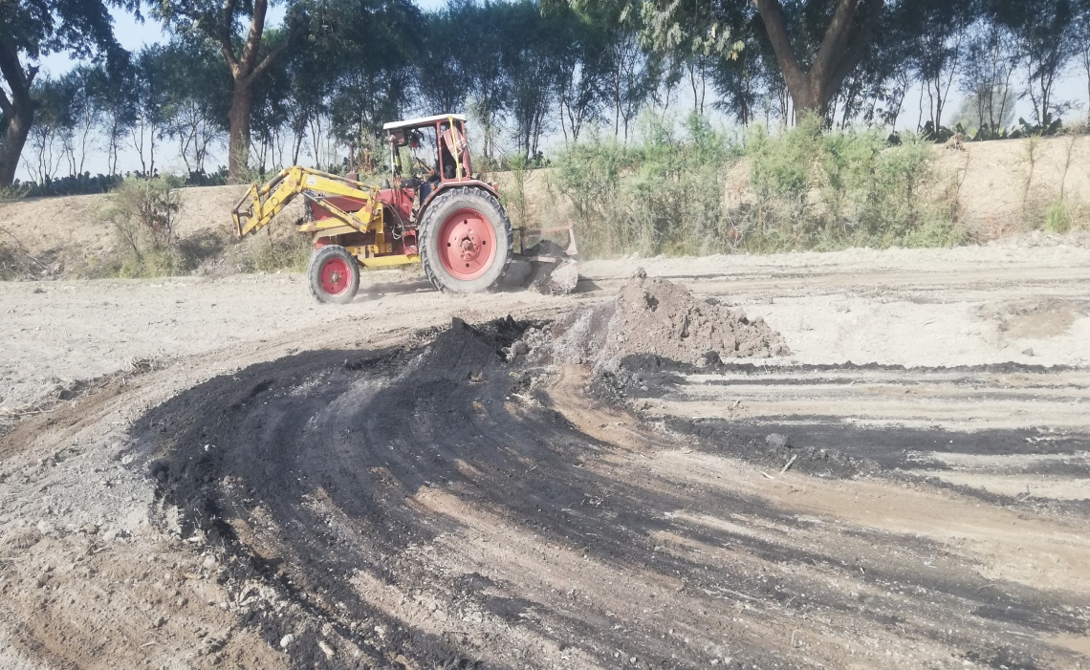
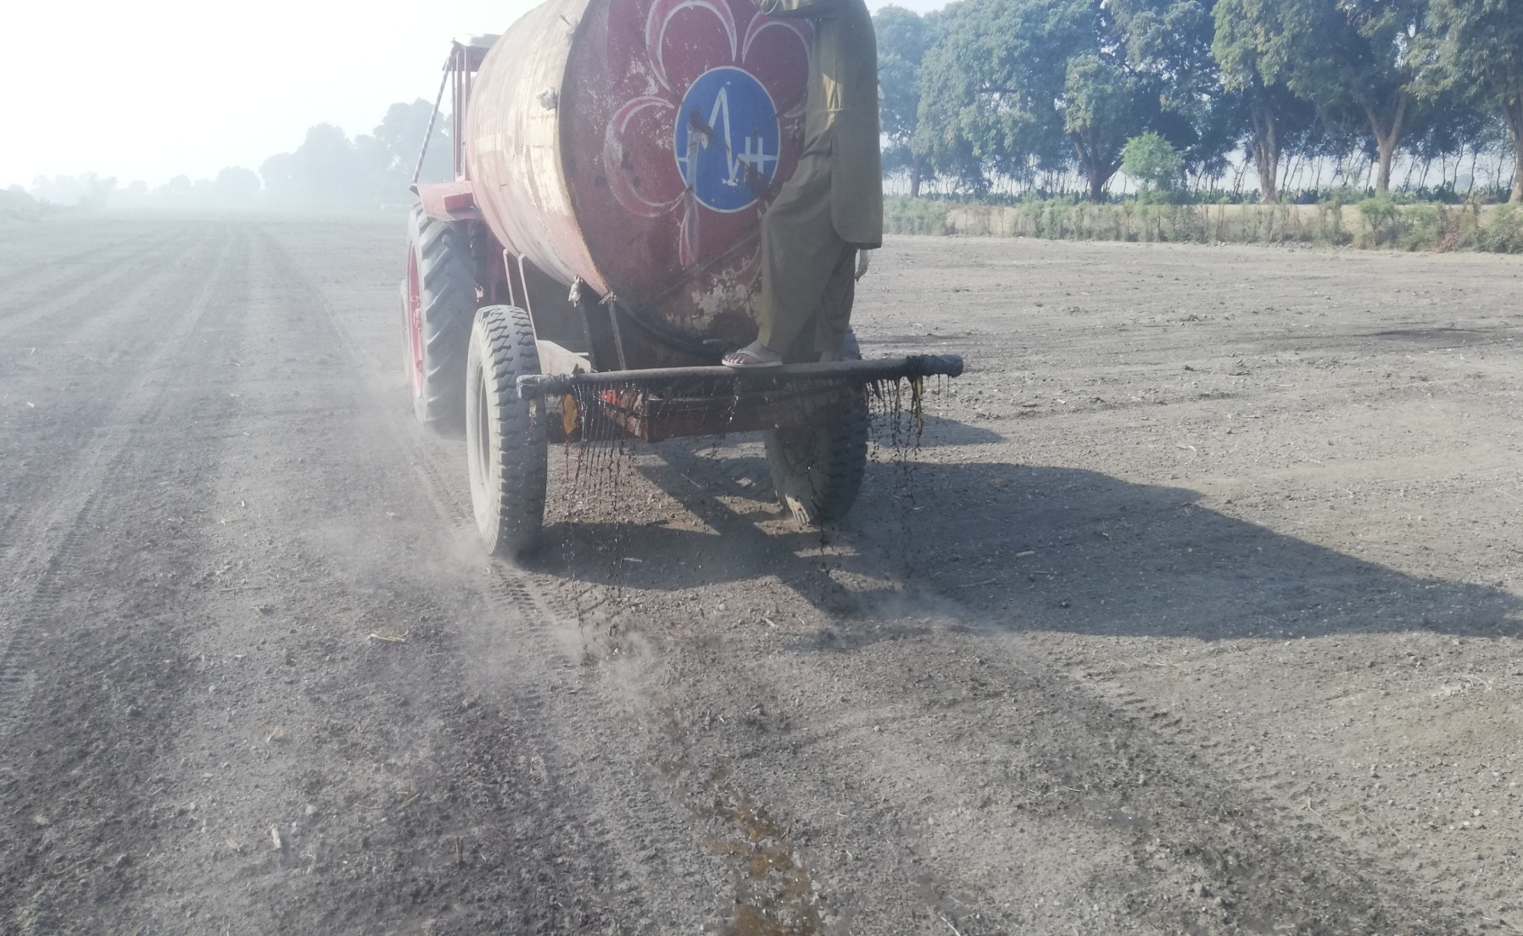
INTEGRATED USE OF SUGAR INDUSTRY BIO-PRODUCTS @ MSM FARM
PLOT # | PLOT SIZE | VARIETIES | PRESS-MUD | FLY-ASH | DSW
01 | 3.00 Acres | YT-TH-55 | 48 tons | 36 tons | 6,000 liters
02 | 2.50 Acres | CSSG-676 | 30 tons | 20 tons | 4,000 liters
Doses of Press-mud, Fly-Ash and DSW was used 16 t, 12.t and 2,000 L in Plot # 01 and 12 t, 8 t and 1,600 L in Plot#02 respectively per acre in sugarcane crop. Press-Mud & Fly-Ash have been dumped after leveling the selected plots, spread out the unloaded heaps uniformly by tractor and showered treated DSW. A flood irrigation has done to circulate the applied objects evenly into the field. After deep ploughing sugarcane sown, no commercial fertilizers applied.

Slide 8

VIDEO by double click

